Slide 1

Q1 2026 Board Meeting
February 12, 2026
Q4 2025 Review / FY 2025 Look Back

Slide 2
Agenda
2025 Look Back
Financial Review (Q4, FY 2025, Budget 2026)
Consulting Sales Review
Delivery Update
Marketing Update
Q1 2026 Company Goals
2

Slide 3
2025 Look Back – Sales
Wins
Misses
Consulting bookings steady at ~$3M/quarter; pipeline adds trending favorably throughout the year
KSA pipeline growing: LLCP emerged as a strong KSA; Core Industrial similarly situated (using x-portfolio as a blueprint)
GP Stakes – Ridge Lake (Gridiron, Gauge)
15 new PE logos; 40 consulting projects sold
Greater involvement of delivery/SME in scoping/closing calls
Additions: David (CT), Jake (Bluwave). Offer out to Kevin Buckley (ex-Grant Thornton PE sales)
Consulting bookings consistently below budget ($3M actual vs. $4.8–$5.3M budget each quarter)
Small parcel bookings significantly below plan + churn
BDR turnover: Jack/CJ (underperformance) and Shaun departure
Close rate at ~30%
2026 Focus
Add 6–8 new KSAs; continue to improve KSA opportunity contributions to improve pipeline consistency
Continue to iterate on BDM model: NYC-based hires, improved comp model, senior pairing
Prioritizing X-Portfolio data collection; creating value/goodwill through PVP
Verticalization of sales approach for top verticals (multi-site healthcare, HVAC, manufacturing)
3

Slide 4
2025 Look Back – Delivery
Wins
Misses
Strong project delivery, with highlights including RoadSafe ($5.7M savings across 3 phases), Epika ($1.5M in savings), Hy-Tek ($1.2M in savings), Naturpak ($1.1M in savings), D&H ($1.5M in savings)
New industries: auto collision (OpenRoad), warehousing automation (Hy-Tek), pet food (NaturPak), nutritionals (K-1/Everest)
COGS scope expansion successful and increasing across projects
Strong client satisfaction – NPS results positive; enthusiastic participation in video customer testimonials
Successful team development: 4 promotions; 8 new hires (3 departures) (Jan. ‘25 – ‘Feb. 26); Delivery Team-wide training held in October, Delivery Manager team-building offsites held Jan. & Sept. 2025
Colab91 (offshore India delivery) relationship; 3 resources (2 delivery, 1 AP support) starting between Feb. – May 2026
Only 13% of projects closed out on-time (in a 6 month time frame) - on-time delivery remains a challenge
Revenue collection challenges on contingent/hybrid projects – baseline reductions impacted ROI achievement (while contractual language protects us when baselines fall more than 20%, this language is challenging to enforce)
Managed spend offering gained minimal traction
2026 Focus
Improve consistency of delivery through New Hire training (to be held 2/24-2/25 in Chicago) and roll out of Delivery Principles (“The Treya Way”), Delivery Playbook, and slide template library by start of Q2 2026
Improve on-time delivery through granular Wrike milestone tracking and more proactive client communication re: delays
100% revenue collection: obtain baseline/savings approval as early in project as possible; escalate unpaid invoices much earlier
Continue COGS scope expansion as a differentiator
Re-allocate CDO’s time through delegation and reprioritization to increase focus on client relationship development and business development support and decrease focus on day-to-day project management support
4

Slide 5
2025 Look Back – Marketing
Wins
Misses
Marketing plan established for 2026
Customer video testimonials (3/5 complete; 2 scheduled)
3/31 – 4/1 ”Treya PE Summit”
Initiated initial demand gen campaigns
LLM/AI based content generation - POC
Very sluggish initial progress with marketing plan and activities and an appropriate marketing cadence
Have not yet reached a 100% rhythm
2026 Focus
Support for KSA expansion; Improved demand gen (PVP, Parcel, Consulting); Sales Enablement
More details on slides 19-20
5

Slide 6
2025 Look Back – PVP
Wins
Misses
PVP concept validated: multiple vendor partners actively engaged in consulting projects
Great buy-in from Delivery team driving widescale adoption in consulting channel
Key hire of VP level sales position dedicated to PVP onboarded and producing
More than $35M spend converted to date, with $40k revenue recognized in December
PVP revenue still modest relative to long-term potential
Pipeline and conversion tracking still to be formalized in Salesforce and beyond
Slower conversion than expected: time from "conversion" to first dollar shipped can drag out
No real outbound marketing plan in place
Adoption by PEs at the portfolio level has been limited to date
2026 Focus
100% PVP vendor engagement in eligible consulting project categories
Scale PVP revenue through increased portfolio company adoption and marketing-driven demand gen
Add new PVP vendor categories to expand addressable market; specifically, nail down playbook in Telecom
Establish 2-3 meaningful channel relationships with other service providers (e.g., Harbor, OOCFO Firms, IBs, etc.)
6

Slide 7
2025 Look Back – Org. Health
Wins
Misses
Implemented equity comp structure for managers – aligns incentives and improves retention
Significant delivery team build-out: added multiple new consultants and analysts
Stronger leadership alignment
New sales leadership in place and performing well – stronger execution and accountability
Adopted EOS (Entrepreneurial Operating System) for leadership alignment, accountability, and traction on strategic initiatives
CRO transition mid-year created short-term disruption
2026 Focus
Embed EOS operating rhythm: Level 10 meetings, quarterly rocks, scorecard tracking across all departments
Continue building bench strength in delivery – right-size team for projected 2026 revenue growth
Formalize talent development and succession planning for key roles
Maintain and build on improved leadership and managers group alignment – quarterly strategic offsites
7

Slide 8
2025 Look Back – M&A
Wins
Misses
Developed initial M&A thesis and prioritization framework with market map across fit dimensions
Evaluated multiple opportunities (mostly inbound from bank processes), notable include: Moresby Group, Holden, Acustraetgy
Refined acquisition strategy: acqui-hire identified as lower-risk, higher-probability path for building pricing capability
Did not close any acquisitions in 2025
Moresby Group IOI withdrawn due to elevated valuation expectations
Holden and Acustrategy both ruled out after deeper evaluation (fit and interest gaps respectively)
2026 Focus
Pricing capability remains high priority – acqui-hire as preferred path, with 4 active candidates in pipeline
Continue sourcing right-sized targets with strong complementary fit (product and market synergies) at attractive valuations
Maintain valuation discipline
8

Slide 9
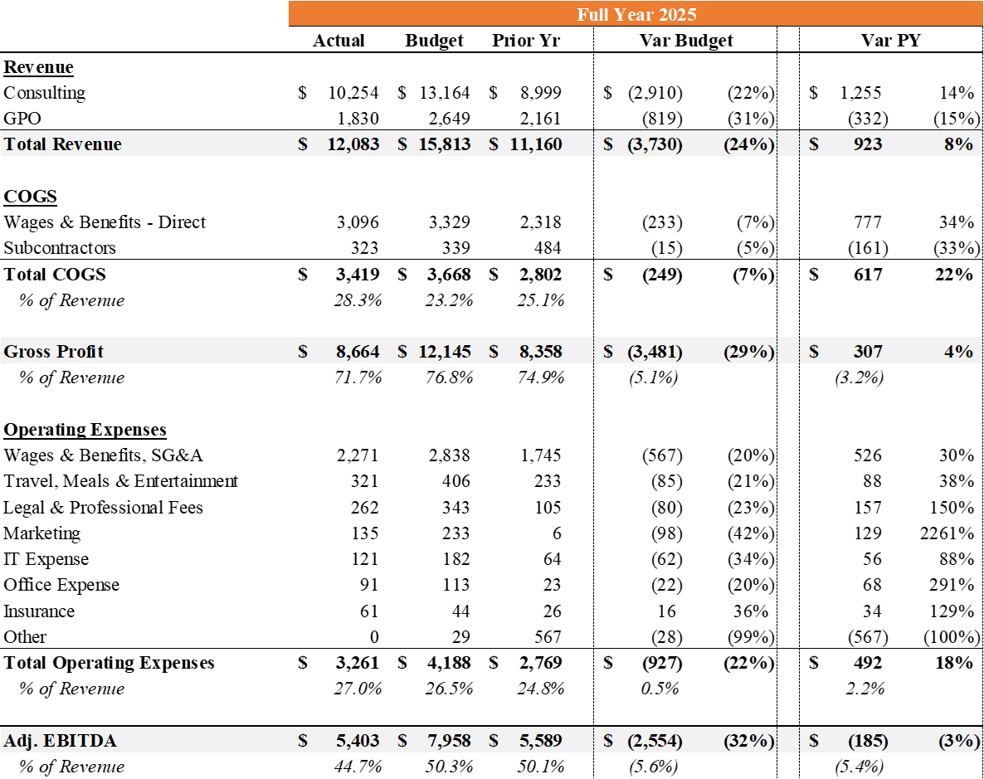
2025 Financial Summary
($ in Thousands)
Revenue: Good growth in consulting revenue in post-audit numbers despite a large miss in bookings ($11.9M vs. $16.3M budget). UPS largely stabilized after significant declines through Q3; PVP revenue starting to offset losses ($150k run rate as of 12/31/25).
Cost of Sales & Gross Profit: Good cost control vs. Budget, with hiring largely deferred to Q4 2025 and Q1 2026.
Opex: Costs significantly lower than plan but higher than the prior year, in line with expanded sales function and infrastructure to support planned growth. Positive variance on wages due to bonus accrual true-up. Under invested in marketing in 2025.
9

Slide 10
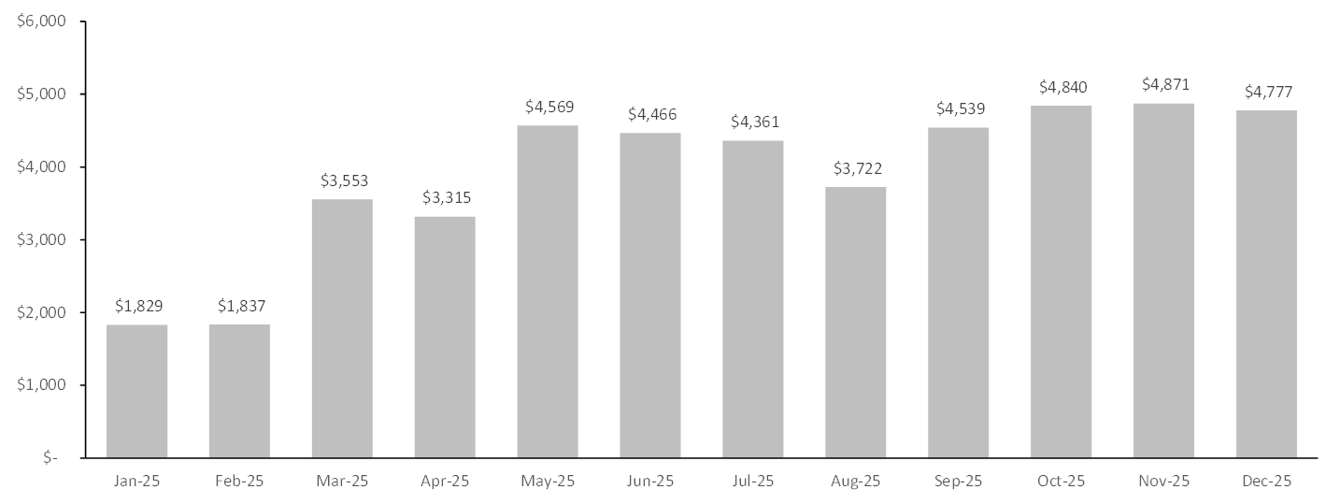
2025 Trended Backlog
($ in Thousands)
$3MM increase in backlog since January 31, 2025, despite more conservative approach to bookings on Hybrid/Contingent projects
Backlog as of December 31, 2025 represents 36% of 2026B consulting revenue
10

Slide 11
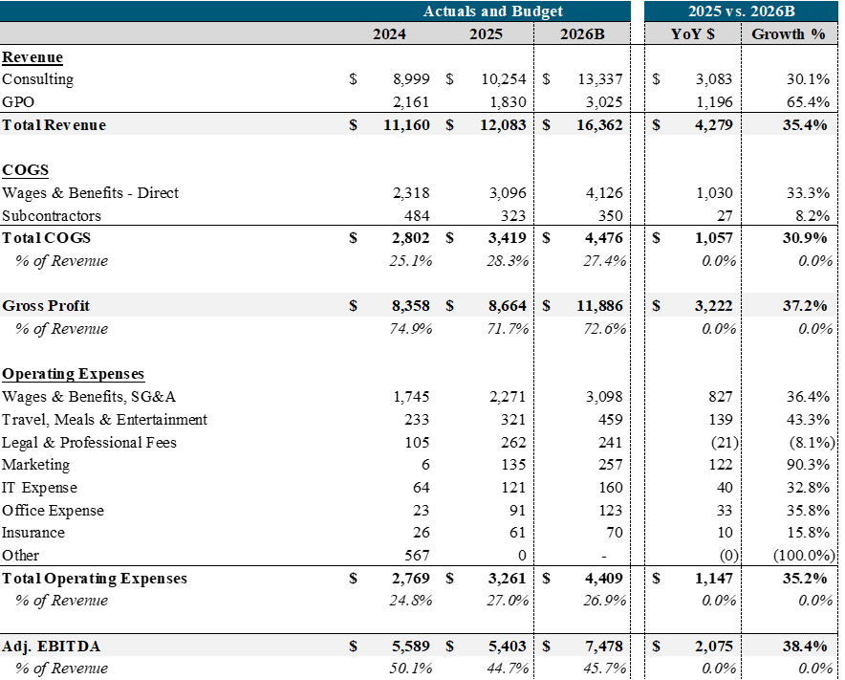
2026 Budget
($ in Thousands)
Revenue: Significant consulting revenue growth driven by strong starting backlog ($4.7MM) and 22% YoY growth in bookings. PVP expected to contribute meaningfully beginning in Q2 2026, which is well supported by current pipeline.
Cost of Sales & Gross Profit: Significant investments made in Q4 2025 and Q1 2026 to return to "full staffing". Collab91 launch critical to maintaining subcontractor cost control.
Opex: YoY increase largely driven by annualization of 2025 hires, as well as the addition of 2 new sales reps (one junior, one senior). Additional investments in marketing planned, including in-market events.
11

Slide 12
FY 2025 Consulting Sales
Sales by Quarter
Sales by Pricing Model
Total: $12.0M (40 deals)
Total: $12.0M (40 deals)
(12 deals)
(8 deals)
(10 deals)
(10 deals)
(55%)
(29%)
(16%)
Bookings steady at ~$3m / quarter [avg. deal size (booked): $300K]
Increasing pivot to hybrid pricing (~55% by booking amount)
12

Slide 13
Consulting Pipeline Adds
Pipeline Adds in 2025
Pipeline Adds by Contributing PE
Total: $42.8M (146 opportunities)
Total: $42.8M (146 opportunities)
8% Trivest Partners
6% LLCP
5% Non-PE
4% Shoreline Equity
4% Wind Point Partners
4% Dunes Point Capital
4% 44 Maple Group
4% Incline Equity
3% HPS Investment
59% 62 Others
(28 opps)
(41 opps)
(39 opps)
(38 opps)
Pipeline adds totaled $42.8M across 146 opportunities [avg. deal size: $293K]
Diversified PE sourcing: top PE (Trivest Partners) accounts for only 8% of pipeline
13

Slide 14
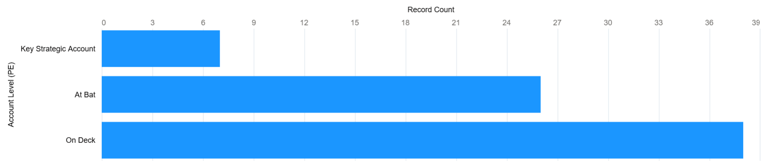
KSA Progress
LLCP cemented as a true KSA in Q4 with 5 consulting projects in Q4
Top KSA candidates for 2026 are: Core Industrial, Gridiron Capital, Gauge Capital, Waud Capital, TZP Group
Major focus among BDMs in 2026 of re-engaging "Warm Prospects" of which we have another 200+ Private Equity Firms
14

Slide 15

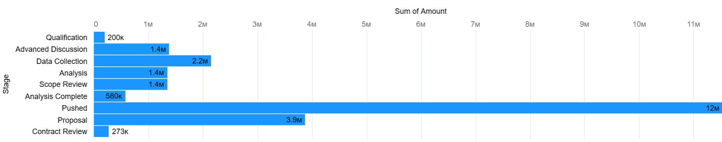
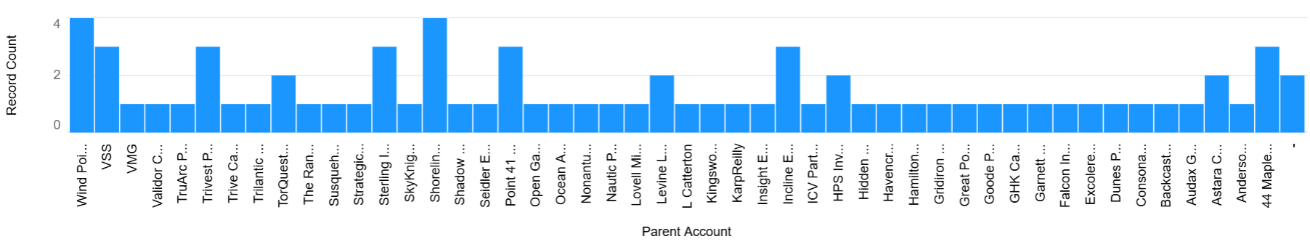
Current Consulting Pipeline
Overall Consulting Pipeline is healthy
Have created "pushed category" to isolate those deals that have pushed out
Open opps across 47 PE firms
15

Slide 16

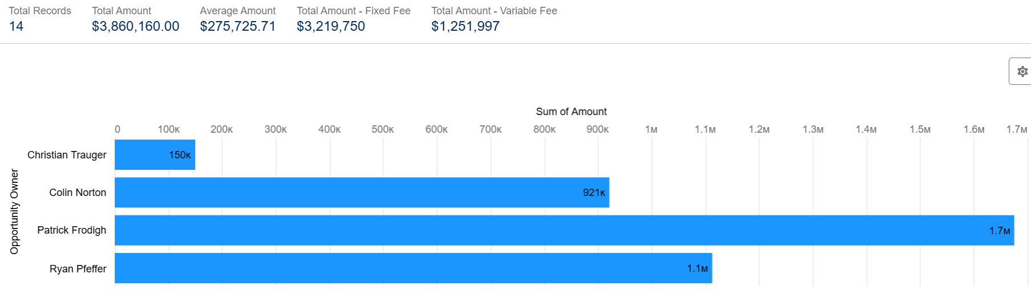
NTP Consulting Pipeline
Healthy NTP Pipeline
Solid contributions from the 3 "legacy" BDMs
14 unique funds represented in the NTP
16

Slide 17
Q4 2025 Delivery Highlights
As of today, active project portfolio: 42 live projects (32 active, 10 closing) across 27 PE firms
Project Highlights
PATCO (Kingswood portco) officially closed out on 11/5 with ~$750K in savings and a happy client CEO
Globo (VSS portco) closed out on 11/13 with ~$300K in final savings
OpenRoad (Trivest portco) officially closed out in December with $457K in final savings, giving us quals in the auto collision repair space
ReFocus (Zenyth portco) – a project still in progress – has already exceeded savings associated with booked revenue by 141%, with current savings in hand of ~$740K, while projected low-end savings were $530K
Project with Double-B Foods (Anderson Group portco) kicked off with an on-site visit in Dallas on 11/6
Tariff-related supplier diversification project with Belt Power (Platte River portco) kicked off on 11/5, with an on-site visit to Grand Rapids, MI
Engagements with USA Water, Milton, IPM, Capsa, and Science Care (all LLCP portcos) and Monarca (Windpoint portco) all kicked off virtually in November & December and are well underway​
Staffing/Recruiting Update​
3 departures in Q4 (1 Consultant, 1 Senior Consultant, 1 Manager)
2 new hires made in November, 2 new hires made in January, and 2 new hires made in February ​
3 from Gibson Consulting
1 from Efficio
1 from KPMG
Colab91 resources interviewed and approved, with starting dates ranging from Feb. – May 2026
2 from Accenture India (1 will provide sales support)
1 from Kearney India
1 open Analyst role and 1 open Manager role remain – we are “slow playing” both, though contemplating extending an offer to a promising Analyst candidate from Gibson to lock in top talent
17

Slide 18
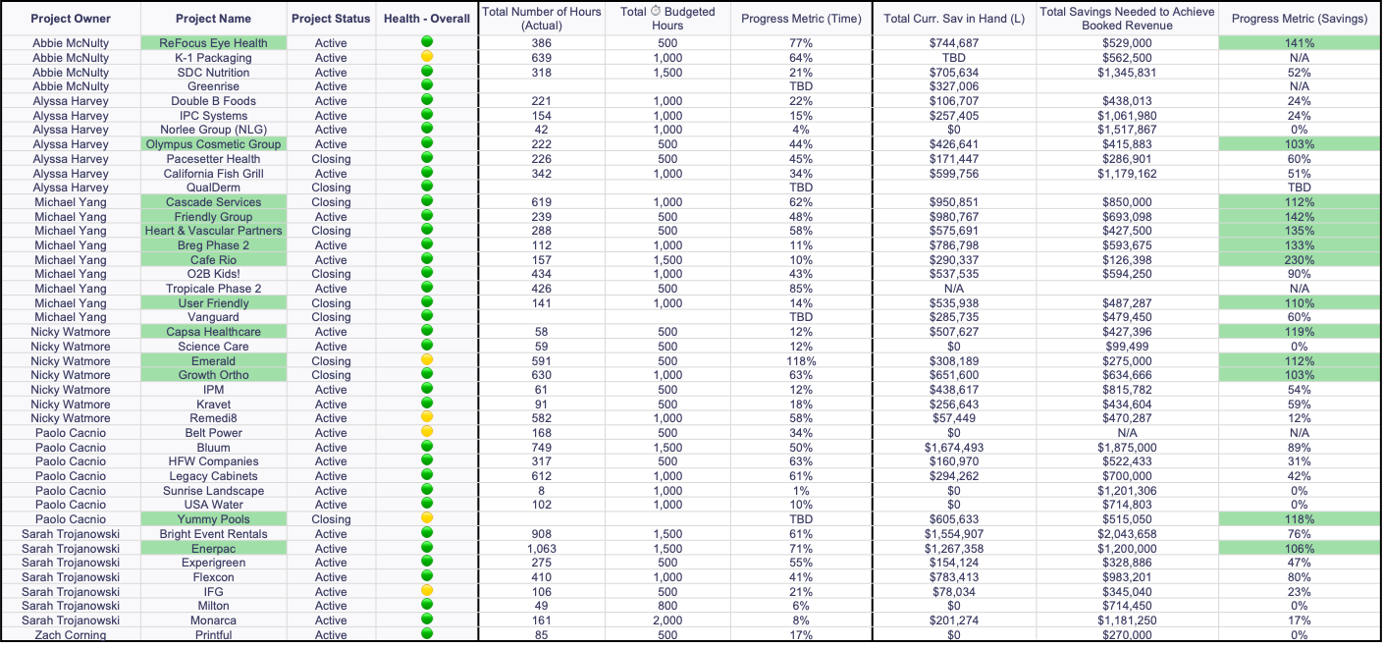
Wrike Excerpt: Project Status Overview
# of Active Projects: 32
# of Closing Projects: 10
# of Yellow Projects: 6
# of Projects Where Current Savings Exceed Those Assoc. with Booked Revenue at Kickoff: 13 (30%)
18

Slide 19
Marketing Plan - 2026
Area | Digital (Email/Social) Marketing | Other | Outcome/KPIs
KSA – Land/Expand | Targeted e-mail marketing (supporting/complementary to BDR efforts) | In-market sports/entertainment/dinner Quarterly in-person updates Value creation reporting | Generate 5 MQLs per Q
Demand Gen. – Key Verticals | Targeted lead gen campaign (Portco; Potentially PE) |  | Generate 5 MQLs per Q per vertical
Demand Gen. – Parcel | Known Coretrust users (PE) UPS approved PE accounts (Portco) Logistics/transportation heavy PEs not on KSA list (PE) |  | Generate 10 MQLs per Q
Demand Gen. - PVP | Past Treya clients (PE/Portco) Non-KSA PEs (PE) |  | Create 5 MQLs per Q
Demand Gen. - Others | TBD - other high opportunity areas (e-commerce focused offering for instance) |  | TBD
Treya Annual PE Summit |  | Curated 1-2 day off-site targeting 10-15 attendees (anchored around existing clients, target emerging KSAs).
Collateral Update |  | Update master sales / proposal decks
Customer/Market Proof |  | PE endorsements (video, other) Portco endorsements (video, other)
Sales Enablement |  | Create snapshot case study for each successful project Top 5 Verticals – sales fact packs AI based comps/case studies for PE/portco level targeting
Thought Leadership & Market Positioning |  | Blog posts, Newsletter, Media, Linkedin, Conferences
Channel Partner Ecosystem |  | TBD
Other |  | Website update, list management, Warmly, ABM, etc.
Note: Bold = Q1 2026 Priorities
19

Slide 20
Marketing Update – Q1
Treya PE Summit – 3/31 – 4/1 (confirmed attendance from 8 KSAs, reaching out to strong prospects)
3/5 customer video testimonials completed (the other 2 are scheduled)
Demand Gen campaigns initiated (PVP – Engine, Verticals – Healthcare, Parcel)
LLM Based content generation
POC Impact Case Studies generated for 9 sample projects
POC Supplier “Battle Cards” generated (from these sample projects)
20

Slide 21
Q1 2026 Company Goals
# | Goal
1 | 30 Case Studies AI-generated and ready for sales use
2 | AI Team & Cadence Executed; 2 productivity use cases implemented; appropriate management team licenses in place
3 | AI Based Spend Classification Tool – used actively in production
4 | Collab 91- Resources onboarded, trained, evaluated; leadership team readout
5 | Successfully execute Treya PE Summit
6 | BM Resp. Delegation: Identify 2 delegation areas; delegate 1x; ID 2 areas to contribute to; leadership team readout
21

